Slide 1
7.1 Tesla
Professor Burnes
Leeds School of Business
University of Colorado Boulder
Leeds
B U S I N E S S
Page 1

Slide 2
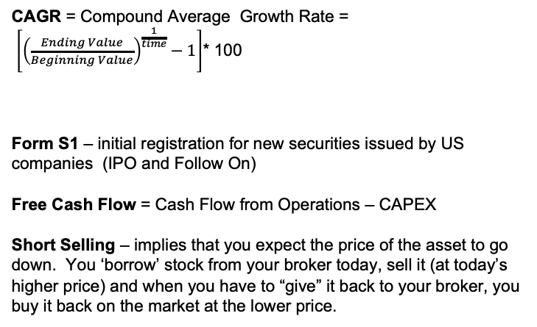
VOCABULARY and calcs
CAGR = Compound Average Growth Rate =
$\left[{\left(\frac{Ending Value}{Beginning Value}\right)}^{\frac{1}{time}}−1\right]$* 100
Form S1 – initial registration for new securities issued by US companies (IPO and Follow On)
Free Cash Flow = Cash Flow from Operations – CAPEX
Short Selling – implies that you expect the price of the asset to go down. You ‘borrow’ stock from your broker today, sell it (at today’s higher price) and when you have to “give” it back to your broker, you buy it back on the market at the lower price.
Multiplying by 100 makes it a percentage

Slide 3
Vocabulary continued
Primary Market: This is the initial offering of the stock. This is the bids/commitment made as a result of roadshow -- the Underwriter(s) (Investment Bank(s)) leading the offering “presells” the shares”
Secondary Market: this is the public exchanges where stocks are traded daily
EPS: Earnings Per Share
PE: Price to Earnings Ratio

Slide 4
What was Tesla’s Strategy by rolling out the Roadster as its first car?
High Price Point to Defray Start Up Costs
Alternatives?

Slide 5
Red Flag or Good Idea??
“In fact, the company stopped taking reservations and instead initiated a waiting list, charging customers $5000 for the opportunity to purchase the sports car priced at over $100,000”

Slide 6
KPIs for Tesla
?? Why is this hard??
Examples
Vehicles Delivered (relative to expectations)
Strategic Partnerships
CEO Stability
Share of EV Market
Share of Vehicle Market
Asset Efficacy/Utilization

Slide 7
COMPS for Tesla
Why is this hard?
First Mover
Luxury Market
American Made
Other than Cars?

Slide 8
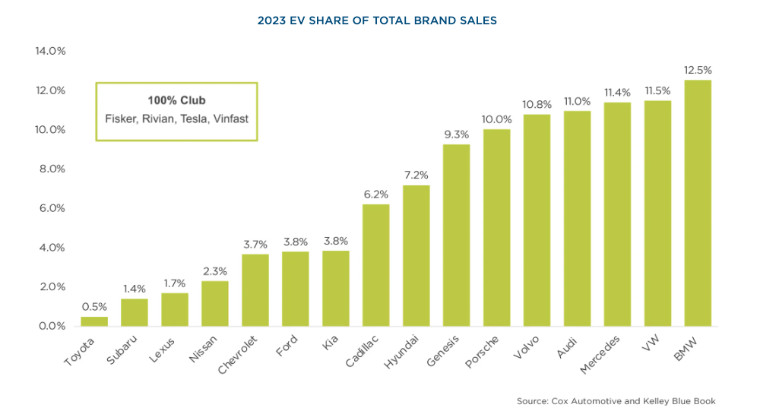
Let’s Look at 2023
1.2 million EVs sold in US
EV Share of US market 7.6%, vs 5.9% in 2022 and 2.2% of total market 2018
Tesla had 65% of total market in 2022, and 55% of total market in 2023
3 New Entrants to 100% club since 2022

Slide 9
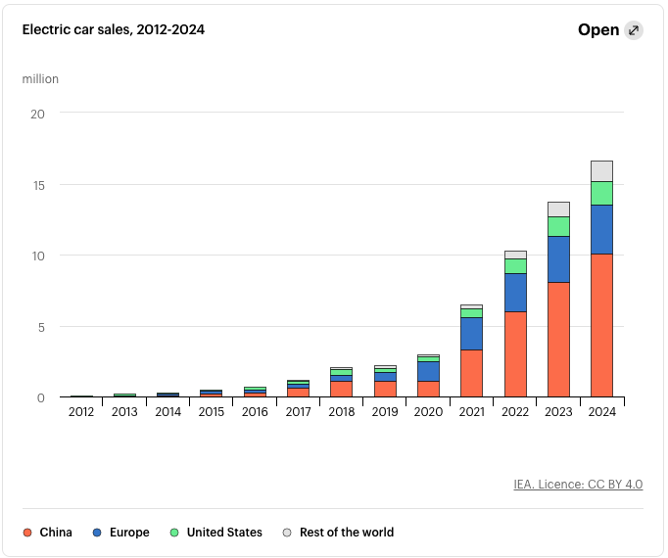
Growth in EV Market Globally
Relative Shares Rebalancing
Source: EV Car Sales 2012-2024

Slide 10
EV Sales US, 2018
In 2018, Tesla had 53.79% of the US EV market in sales and 1.13% of the Total US new vehicle market
For comparison, Ford had 2.51% of the US EV market and 13.7% of the total market
Source: EV Sales US 2018

Slide 11
Let’s take a look at some of the calcs….

Slide 12
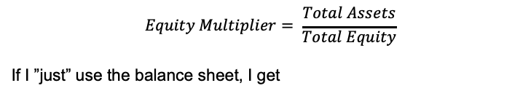
The Ugly Piece is the Equity Multiplier
$$Equity Multiplier= \frac{Total Assets}{Total Equity}$$
If I ”just” use the balance sheet, I get
 | 2011 | 2012
Assets | 713,448 | 1,141,190
Equity | 224,045 | 124,700
Equity Multiplier | 3.18 | 8.93

Slide 13
But this doesn’t make sense… why not?
$231,468
How much equity did Tesla raise in 2011?
How about 2012?
The ACTUAL Equity in Tesla was:
EXCEPT:
Shareholders carry the accumulated LOSS
$221,496
2011 | 2012
893,336 | 1,190,191

Slide 14
The “implied” equity multiplier is
 | 2011 | 2012
Assets | 713,448 | 1,141,190
Equity | 893,336 | 1,190,191
Equity Multiplier | .8 | .94
This is really tricky… because it isn’t the leverage, it’s the losses.
But it underscores the market’s concern regarding Tesla’s performance

Slide 15
This is an interesting story for us…
Let’s look at the history of Tesla’s Stock Price, EPS and PE Ratio
Tesla PE Ratio
What makes this interesting?
TTM Net EPS
Stock Price
PE Ratio
Time to Positive Earnings!
Time for Share Price Growth (note: splits (2020), buybacks authorized 2022)
Dynamic Relationship Between Price and Earnings

Slide 16
Do they need to keep raising money?
Net Burn.
Operational Changes??
CAPEX?
R&D?
So Yes. Need to Raise Capital.
Debt or Equity??
Your Suggestions for what they can do to best prepare to raise Equity?

Slide 17
Suggestions!

Slide 18
New Tool -- CapitalIQpro
Vpn
CU Library
Databases
Go to C
CapitalIQPro
click, enroll as new (use CU address, don’t need to use CU password)

Slide 19
Wednesday, 10/8
The Cash Cycle
Time and Cost Matter.

